Slide 1



STATE COUNCIL OF EDUCATIONAL RESEARCH AND TRAINING
CHENNAI-600006.
STATE LEVEL TRAINING FOR DISTRICT RESOURCE GROUP (XII STD NEW BIOLOGY –BOTANY/ BOTANY NEW TEXT BOOK)
UNIT VI REPRODUCTION IN PLANTS
Chapter 1 Asexual and Sexual Reproduction in Plants

Slide 2

Chapter 1 Asexual and Sexual Reproduction in Plants
UNIT VI REPRODUCTION IN PLANTS
Objectives
History of the subject.
Recent information in the relevant field.
Information on plant reproduction with interdisciplinary approach.
Significance of plant reproduction with reference to existence and functioning of other life forms.
Opportunity for Discovery learning.
The skill of observation through the dissection and drawing .
Impart Scientific temper.
Build confidence to face the challenges in the society.
To develop resource materials to facilitate learning.
Opportunity for competitive exams.
Entrepreneurship.

Slide 3
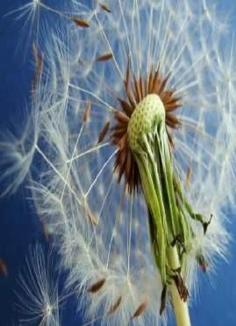
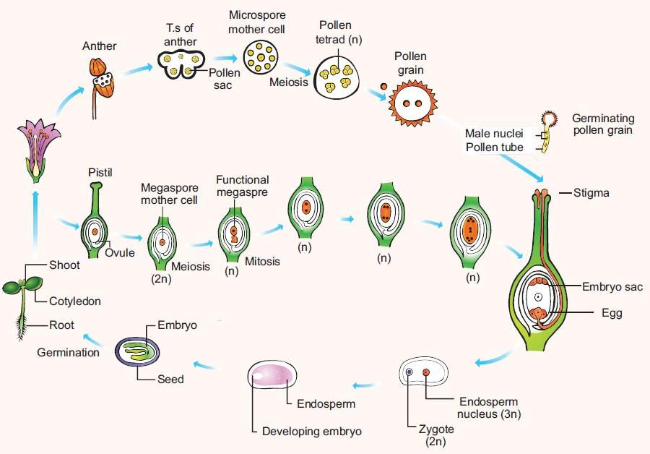


UNIT VI REPRODUCTION IN PLANTS
Chapter 1 Asexual and Sexual Reproduction in Plants
Concept to Application
Milestones in plant reproduction
Reproduction
Types of Reproduction
Structure and development of reproductive parts
Pollination
Fertilization
Development of Embryo
Seed structure
Apomixis, Polyembryony and Parthenocarpy

Slide 4
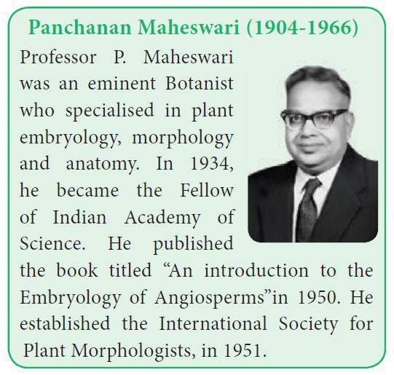
Chapter 1 Asexual and Sexual Reproduction in Plants
UNIT VI REPRODUCTION IN PLANTS
Milestones in Plant Embryology
1682 - Nehemiah Grew - Stamens as the male organ of a flower
1694 - R.J.Camerarius - Structure of a flower, anther, pollen and ovule
1848 – Hofmeister - Structure of pollen tetrad
1898 - S.G.Nawaschin &
1899 - L. Guignard - Double fertilization
1964 - S.Guha and S.C.Maheswari - Haploids from Datura pollen grains
2015 - K.V. Krishnamurthy - Summarized the molecular aspects of pre and post fertilization reproductive development in flowering plants

Slide 5
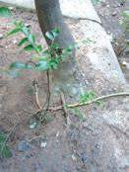
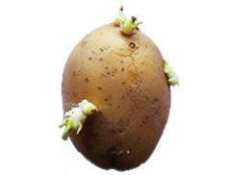

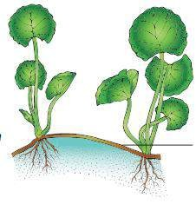
UNIT VI REPRODUCTION IN PLANTS
Chapter 1 Asexual and Sexual Reproduction in Plants
Recalls the reproduction in Lower plants Asexual methods -Zoospores,Aplanospore, Conidia, etc., Sexual methods – Isogamy,Anisogamy and Oogamy.
Reproduction in Higher Plants - Natural

Slide 6
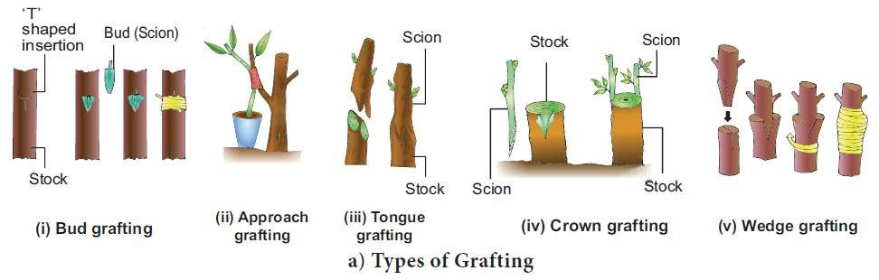
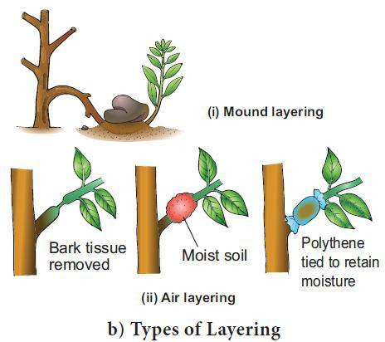
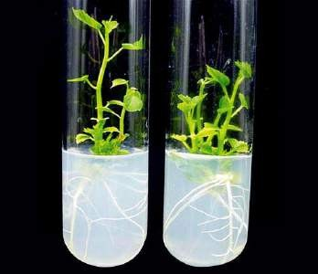
UNIT VI REPRODUCTION IN PLANTS
Chapter 1 Asexual and Sexual Reproduction in Plants
Vegetative Reproduction in Plants
Artificial methods
Tissue culture

Slide 7
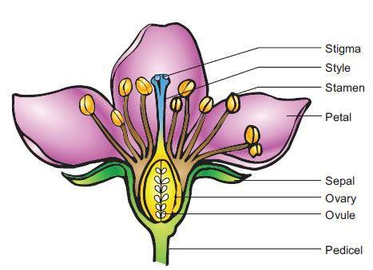
UNIT VI REPRODUCTION IN PLANTS
Chapter 1 Asexual and Sexual Reproduction in Plants
Sexual Reproduction Parts of a Flower
Recalls the parts of a Flower
Calyx Corolla Androecium Gynoecium

Slide 8
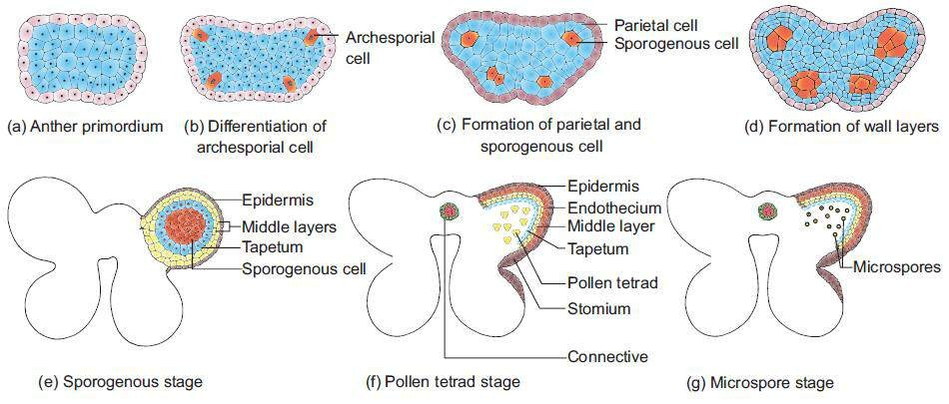
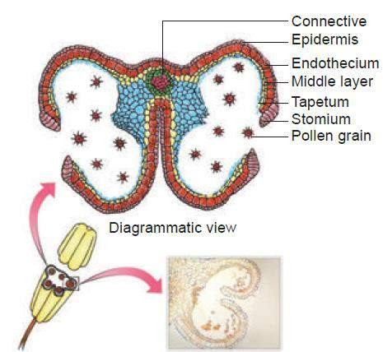
UNIT VI REPRODUCTION IN PLANTS
Chapter 1 Asexual and Sexual Reproduction in Plants
Stages in the development of Anther
Structure of Anther (Anther wall –Anther cavity-
connective)
Tapetum- Types and functions
Microspore and Pollen grain structure

Slide 9
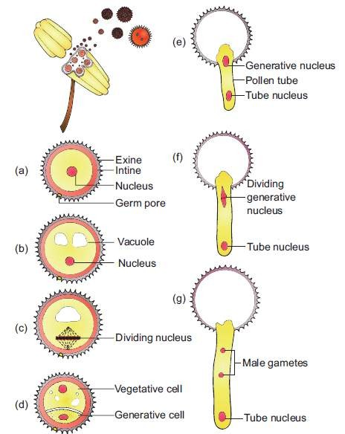
Chapter 1 Asexual and Sexual Reproduction in Plants
UNIT VI REPRODUCTION IN PLANTS
Development of Male gametophyte
Pollen grain
Male gametes

Slide 10
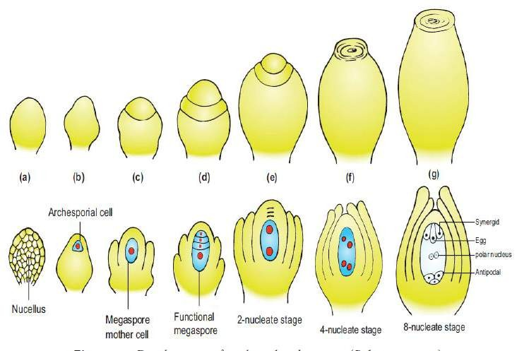
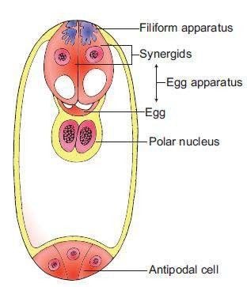
UNIT VI REPRODUCTION IN PLANTS
Chapter 1 Asexual and Sexual Reproduction in Plants
Megasporogenesis
Embryo sac - Structure

Slide 11
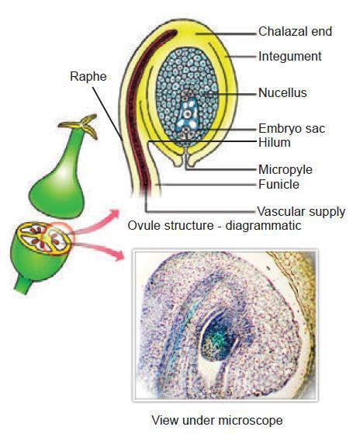
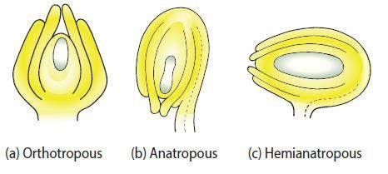
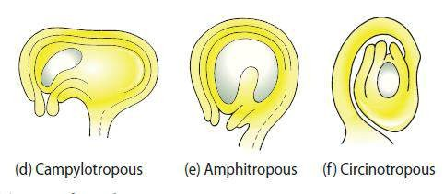
UNIT VI REPRODUCTION IN PLANTS
Chapter 1 Asexual and Sexual Reproduction in Plants
Structure of Ovule Types of Ovule

Slide 12
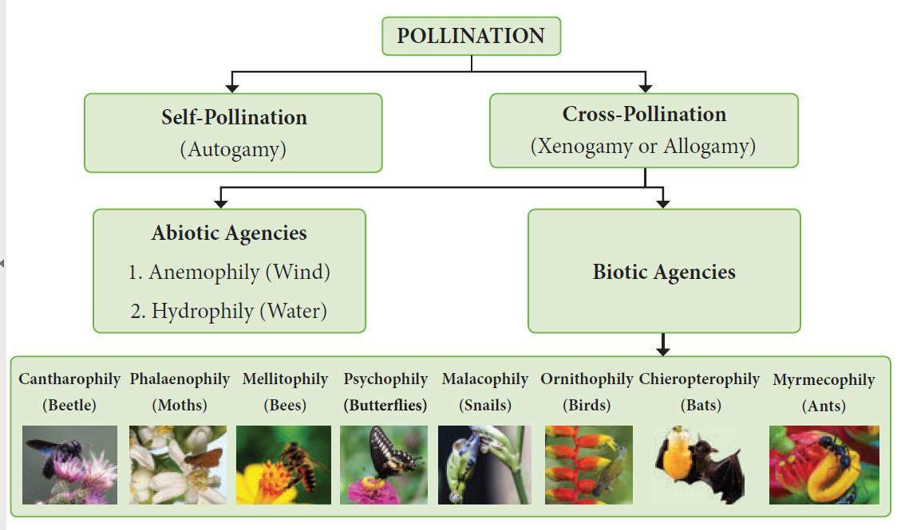
UNIT VI REPRODUCTION IN PLANTS
Chapter 1 Asexual and Sexual Reproduction in Plants

Slide 13
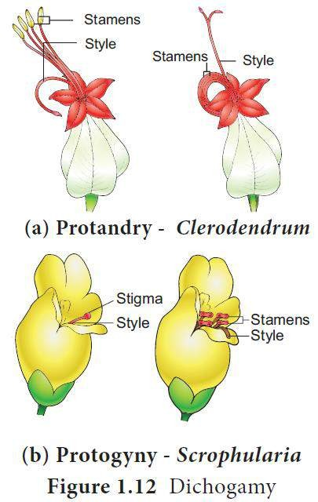
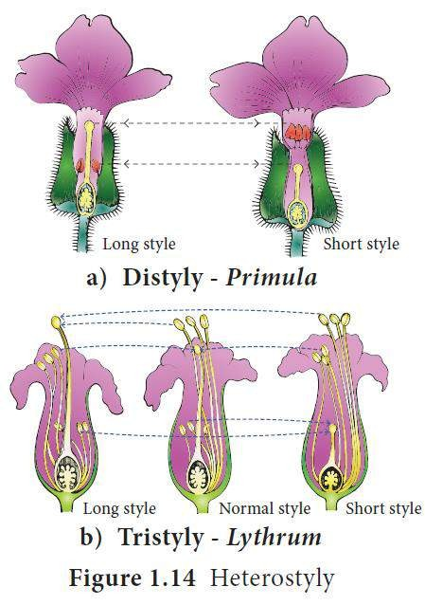
UNIT VI REPRODUCTION IN PLANTS
Chapter 1 Asexual and Sexual Reproduction in Plants
Contrivances of cross pollination

Slide 14
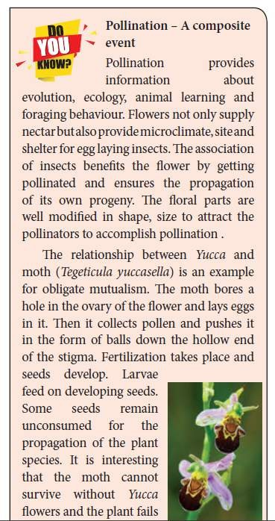
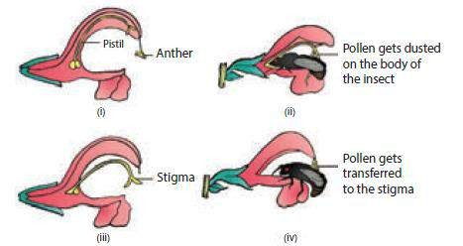
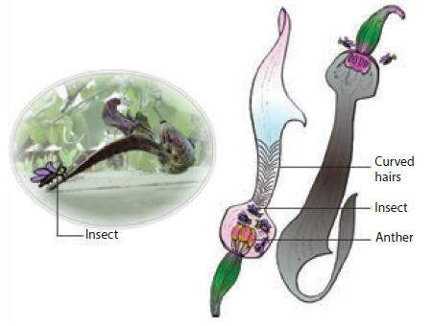
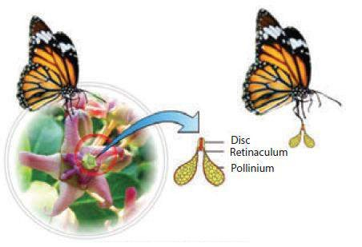
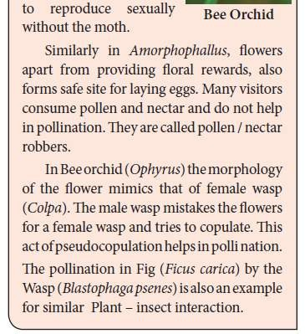
UNIT VI REPRODUCTION IN PLANTS
Chapter 1 Asexual and Sexual Reproduction in Plants
Lever mechanism - Salvia
Pollination Mechanisms
Co-evolution
Pollen biology
Insect- plant interaction Adaptations
Trap mechanism - Aristolochia
Translator mechanism - Calotropis

Slide 15
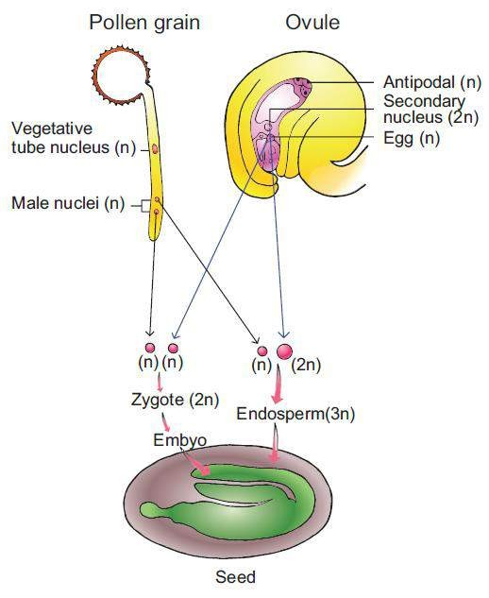
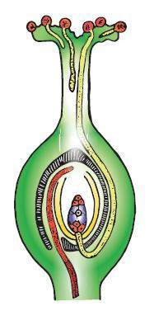
Chapter 1 Asexual and Sexual Reproduction in Plants
UNIT VI REPRODUCTION IN PLANTS
Double Fertilization

Slide 16
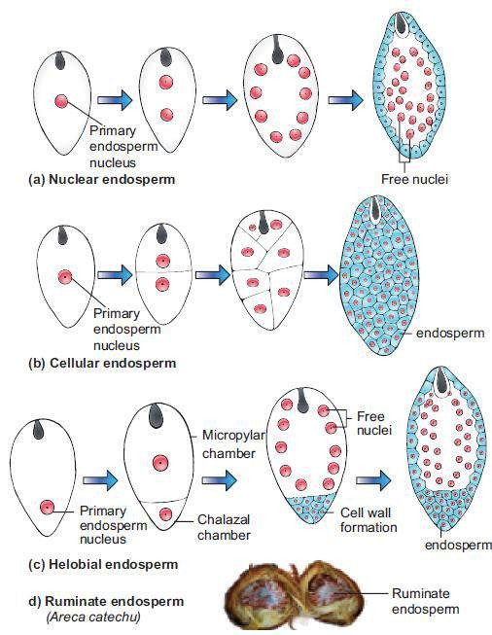
Chapter 1 Asexual and Sexual Reproduction in Plants
UNIT VI REPRODUCTION IN PLANTS
Endosperm Types

Slide 17
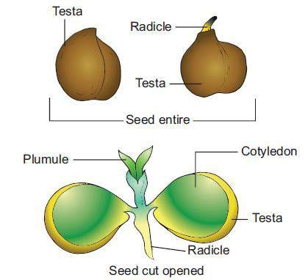
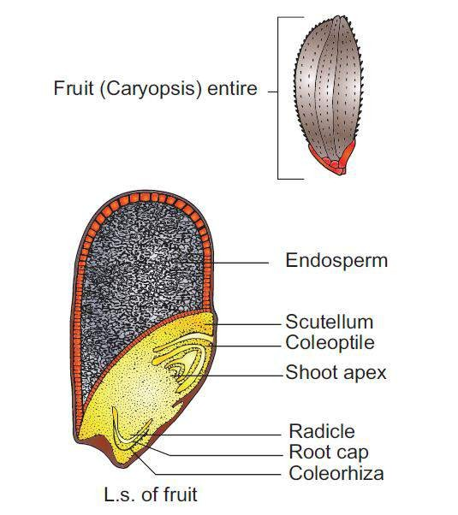
Chapter 1 Asexual and Sexual Reproduction in Plants
UNIT VI REPRODUCTION IN PLANTS
Seed Structure
Dicot (Cicer arientinum)
Monocot (Oryza sativa)

Slide 18
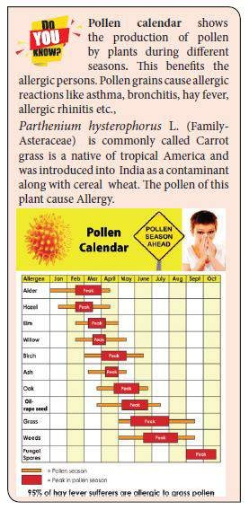
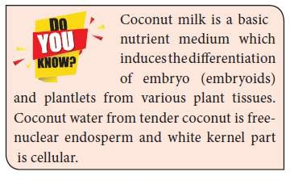
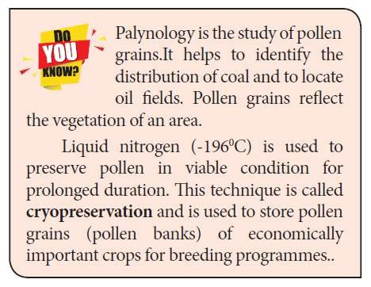
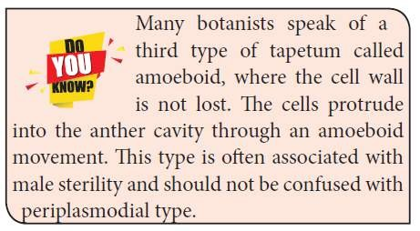
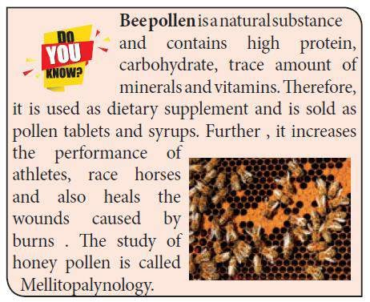
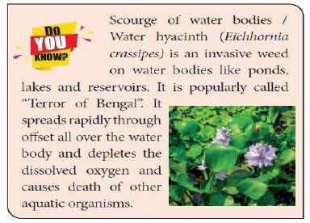
Chapter 1 Asexual and Sexual Reproduction in Plants
UNIT VI REPRODUCTION IN PLANTS
Do You Know ?

Slide 19
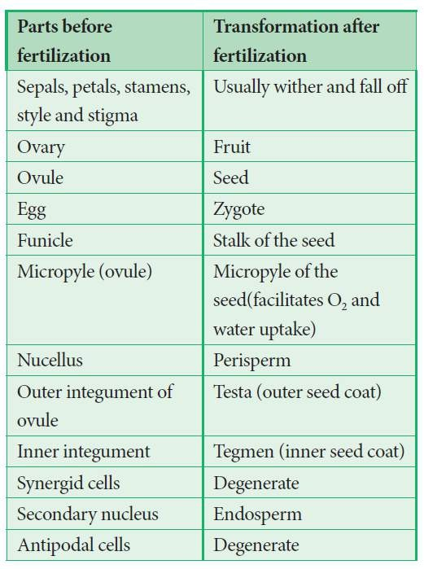
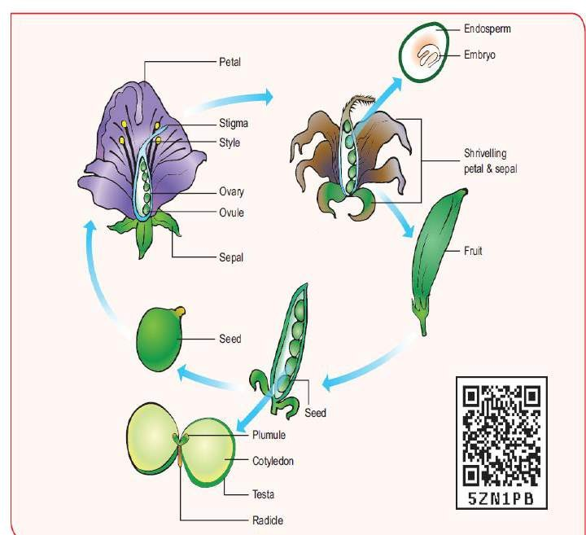
UNIT VI REPRODUCTION IN PLANTS
Chapter 1 Asexual and Sexual Reproduction in Plants
Post Fertilization Changes

Slide 20
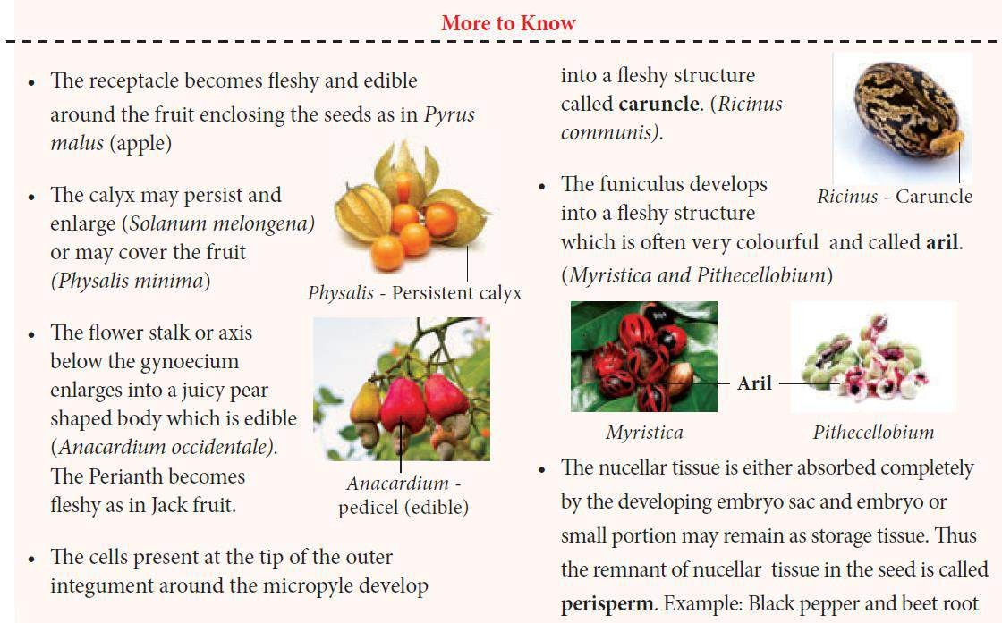
UNIT VI REPRODUCTION IN PLANTS
Chapter 1 Asexual and Sexual Reproduction in Plants

Slide 21
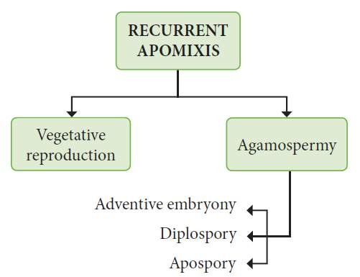
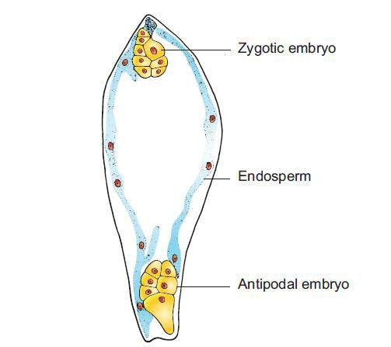
Chapter 1 Asexual and Sexual Reproduction in Plants
Apomixis
Polyembryony
Recurrent & Non-Recurrent types

Slide 22
Chapter 1 Asexual and Sexual Reproduction in Plants
UNIT VI REPRODUCTION IN PLANTS
Summary

Slide 23
UNIT VI REPRODUCTION IN PLANTS
Chapter 1 Asexual and Sexual Reproduction in Plants
Outcomes:
Recognise the contribution of eminent Botanists towards reproduction
Differentiate the parts of a flower.
Trace the steps involved in Microsporogenesis and Megasporogenensis.
Compare the types of pollination and appreciate the importance of this mechanism.
Promote the need for holistic approach to conserve plants and animals.
Appreciate the modification found in plants to ensure pollination.
Promote discovery learning ( Co-evolution, mimicry etc.,)
Prepare for the competitive examinations.
Acquire the skill of different plant propagation technique thus developing
entrepreneurship (Nursery, Bee Pollen etc.,)
Address the environmental problem ( Eichhornia and Pollen allergy )

Slide 24

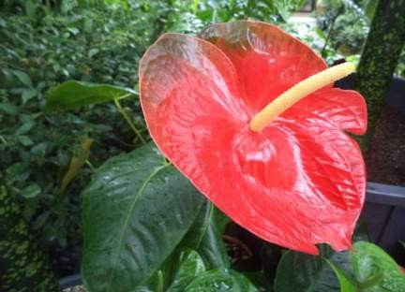
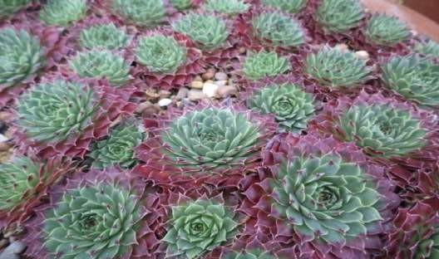






Don’t take rest after your first victory
Because if you fail in second, More lips are waiting to say
That your first victory was just luck
Dr.APJ Abdul Kalam

